Slide 1













Saas Funnel Analysis
From Data to Actionable Insights
Report Date: December 12, 2025
PREPARED BY: MAYANK P. SAVANI
Data-Driven Decision Making
User-Centric Approach
Growth Optimization

Slide 2












Business Problem & Objectives
Current Challenges
Objectives
Inconsistent Conversion Rates
End-to-End Analytics Pipeline
Significant drop-offs at various stages of the acquisition funnel, particularly between signup and email verification.
Establish a comprehensive analytics framework encompassing data ingestion, modeling, and insights generation.
High Churn Rates
Unusually high long-term churn rate indicating issues with user retention and satisfaction.
Identify Retention Patterns
Determine behaviors correlated with user retention and identify users at risk of churning.
Lack of Insights
Need for a comprehensive analytical framework to identify user drop-off points and behaviors correlated with retention.
Support Data-Driven Decisions
Provide actionable insights to support data-driven product and growth decisions.
Saas Funnel Analysis
Page 2 of 10

Slide 3




















System Architecture & Methodology
The analytical framework for SaaS funnel analysis is built upon a robust system architecture designed for end-to-end data processing, from ingestion to actionable insights.
Data Ingestion
Data Processing
Insights Generation
Modeling
Reporting
Collecting raw user event data
Cleaning and transforming data
Applying analytical models
Deriving actionable insights
Visualizing findings
Data Sources
Analysis Methods
Business Impact
Web and mobile events
Funnel analysis
Identify drop-off points
User registration data
Retention cohort analysis
Optimize user onboarding
Feature usage patterns
Churn prediction modeling
Reduce churn risk
SaaS Funnel Analysis
Page 3 of 10

Slide 4











Dataset Overview
5,000
Unique Users
Entire Lifecycle
User Journey
Behavioral Patterns
Comprehensive dataset capturing user interactions from initial acquisition to long-term retention.
Complete visibility into user journey through five funnel stages, analyzing drop-off points.
Rich behavioral data enabling identification of patterns correlated with retention and churn.
Dataset enables analysis of user behavior lifecycle, funnel performance, retention, and churn patterns.
SaaS Funnel Analysis
Page 4 of 10

Slide 5




















Funnel Analysis - Stage Breakdown
Landing Page → Signup
Initial step where users visit the landing page and proceed to register.
Key Conversion Insights
Signup → Email Verification
Significant Drop-off at Email Verification
Users complete registration and verify their email address.
A notable percentage of users drop off between the signup and email verification stages, indicating a potential friction point in the early onboarding process.
Verification → First Login
Following email verification, users successfully log in for the first time.
Trial-to-Subscription Gap
A considerable number of users initiate trials but do not convert to paid subscriptions, suggesting challenges in demonstrating value during the trial period.
Login → Trial Start
Users initiate a product trial after their first login.
Feature Usage Correlates with Subscription
Trial Start → Subscription
There is a strong correlation between active feature usage during the trial period and successful conversion to a paid subscription.
Users convert from a trial to a paid subscription.
SaaS Funnel Analysis
Page 5 of 10

Slide 6







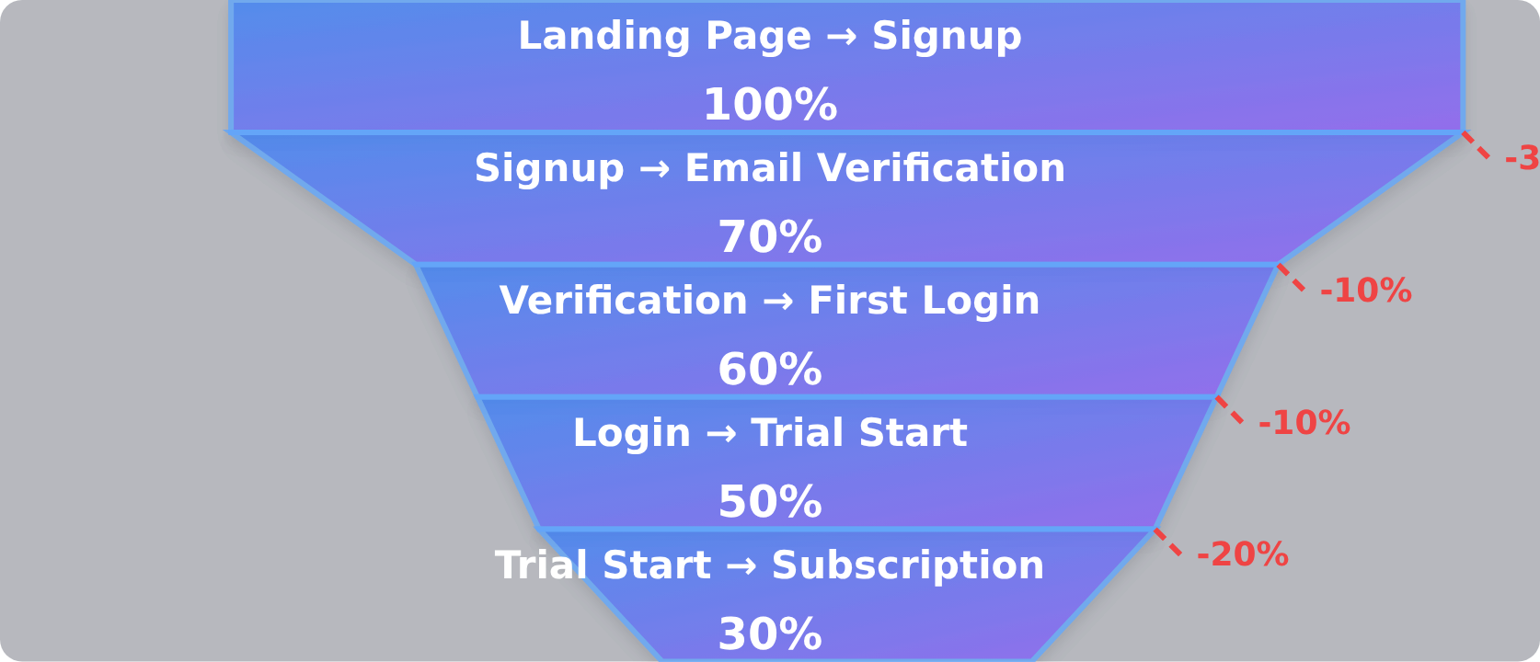
















Conversion Insights & Key Findings
Critical Drop-off Points
Feature Usage Correlation
Strong Correlation
85% Correlation Rate
Active feature usage during trial strongly correlates with successful conversion to paid subscription
Key Takeaway
Email Verification Drop-off
Early engagement with core product functionalities is a critical predictor of conversion success.
Significant users drop off between signup and email verification, indicating friction in early onboarding.
Actionable Insight
Trial-to-Subscription Gap
Users who engage with key features during trial are more likely to convert, highlighting guided discovery importance.
Many users initiate trials but don't convert to paid subscriptions, suggesting value demonstration challenges.
Saas Funnel Analysis
Page 6 of 10

Slide 7

















Retention & Churn Analysis
Retention Metrics
Retention Over Time
Retention analysis measures the percentage of users who return to perform any activity after their initial signup. This report focuses on D1, D7, and D30 cohorts to assess engagement quality and long-term product value.
Key Insights
D1 Cohort
Declining retention rates indicate potential issues with user engagement or product-market fit.
Measures user return the day after signup. Indicates initial product satisfaction and immediate value proposition.
Churn analysis helps identify patterns in user behavior that precede cancellation.
D7 Cohort
Evaluates retention one week after signup. Shows whether users find sustained value during the initial engagement period.
D30 Cohort
Assesses retention one month after signup. Represents long-term product value and customer satisfaction.
Saas Funnel Analysis
Page 7 of 10

Slide 8














Strategic Recommendations
Based on our analysis, we've identified four key areas for improvement:
Improve Early-Stage Onboarding
Strengthen Trial Activation
Streamline the verification process to address high drop-off between signup and email verification.
Implement guided tours to encourage deeper engagement during trials, as feature usage predicts conversion.
Expected impact: Reduce early-stage drop-off
Expected impact: Increase trial-to-subscription conversion
Implement Lifecycle Triggers
Optimize Device-Specific UX
Use automated in-app nudges for users with low engagement to proactively address potential churn.
Address higher churn among mobile users by optimizing UX flows for iOS and Android platforms.
Expected impact: Reduce churn rate
Expected impact: Improve mobile retention
SaaS Funnel Analysis
Page 8 of 10

Slide 9



















Implementation & Next Steps
Data-Driven Implementation
Combining quantitative analysis with qualitative insights for improved UX and growth.
Week 1-2: Immediate Actions
Week 3-4: Short-term Actions
Week 5-6: Long-term Actions
Implement improved email verification
Develop guided tour for trial users
Full analytics pipeline implementation
Launch targeted re-engagement
Implement device-specific UX
Establish automated in-app nudges
Expected Outcomes
Improved Retention
Enhanced Funnel
Sustainable Growth
Reduced churn through targeted interventions
Improved conversion between funnel stages
Data-driven product improvements
SaaS Funnel Analysis
Page 9 of 10

Slide 10













Thank You!
Key Takeaways
Significant drop-off between signup and email verification requires immediate attention
Feature usage during trials strongly correlates with subscription conversion
Users with low feature usage are at high risk of churning
Mobile users show different churn behaviors requiring targeted interventions
Questions & Discussion
We welcome your insights and questions about the SaaS funnel analysis and recommendations
SaaS Funnel Analysis | December 12, 2025
Page 10 of 10

